Slide 1
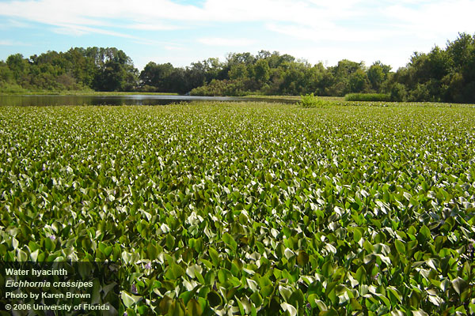




Evaluating the impacts of aquatic invasive plant management
Amy Kendig
Luke Flory, Mark Hoyer, James Leary, and Candice Prince

Slide 2
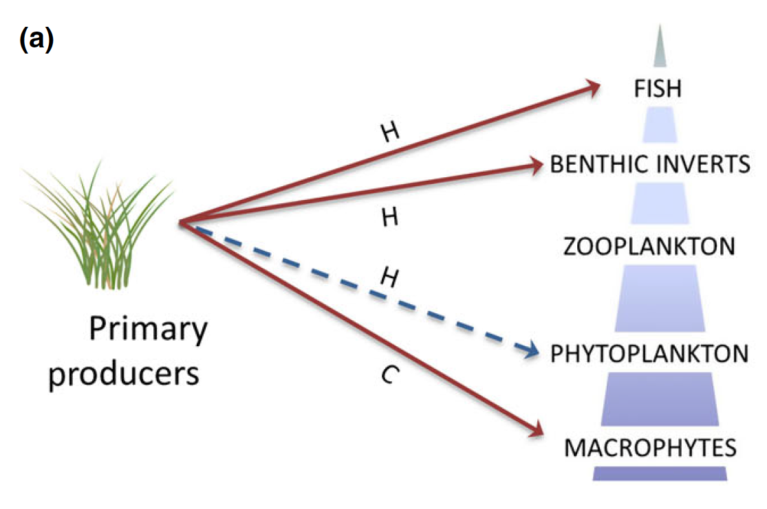
Aquatic invasive plants
Fish composition and richness
Macroinvertebrate diversity
Macrophyte composition, richness, and functional diversity
Water quality
negative
positive
H
habitat modification
C
competition
(Gallardo et al. 2016)
(Thomaz et al. 2015)

Slide 3
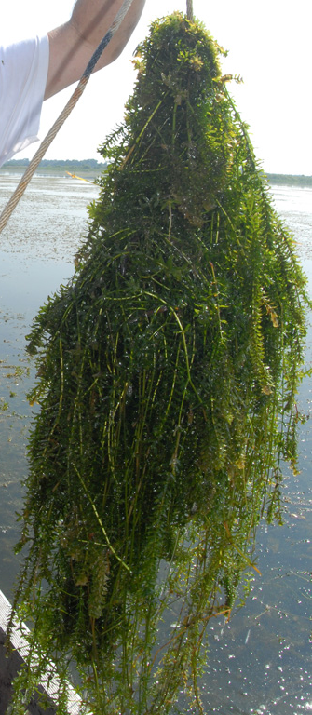
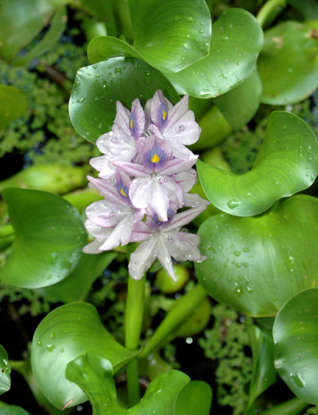
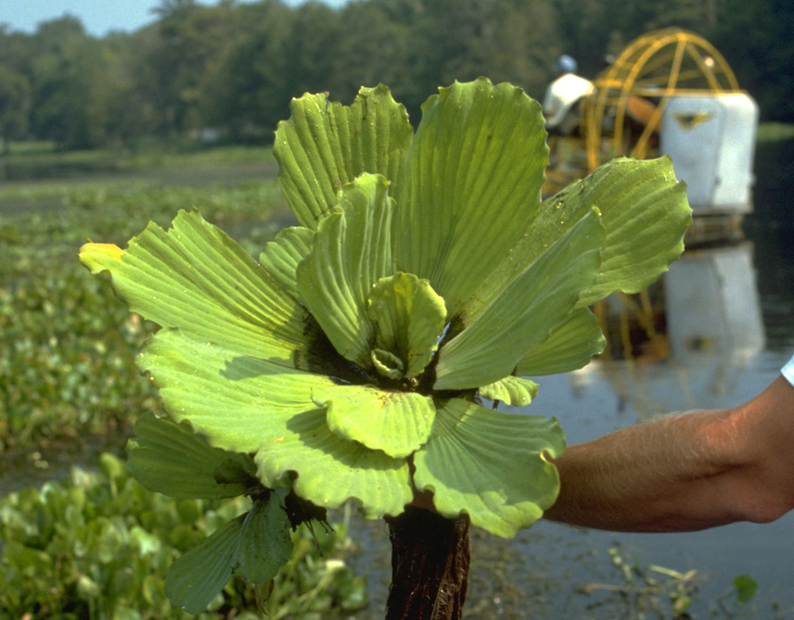
Hydrilla
Hydrilla verticillata
Water hyacinth
Eichhornia crassipes
Water lettuce
Pistia stratiotes
(UF Center for Aquatic Invasive Plants)

Slide 4
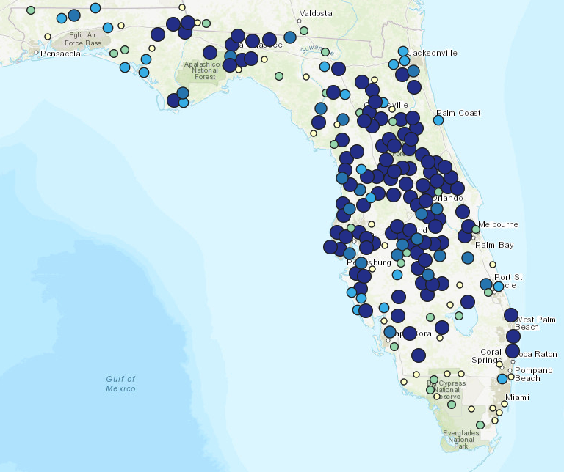
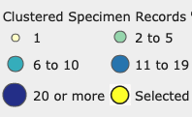
Hydrilla
Hydrilla verticillata
Introduced in the 1950s as an aquarium plant
Native to southeast Asia
Resource competition with macrophytes and phytoplankton
Interferes with fish feeding and spawning
Habitat for macroinvertebrates and some fish
Management began in 1960s
Herbicides, mechanical, and biocontrol
Control costs $3.1–$17.6M annually
(USGS)

Slide 5
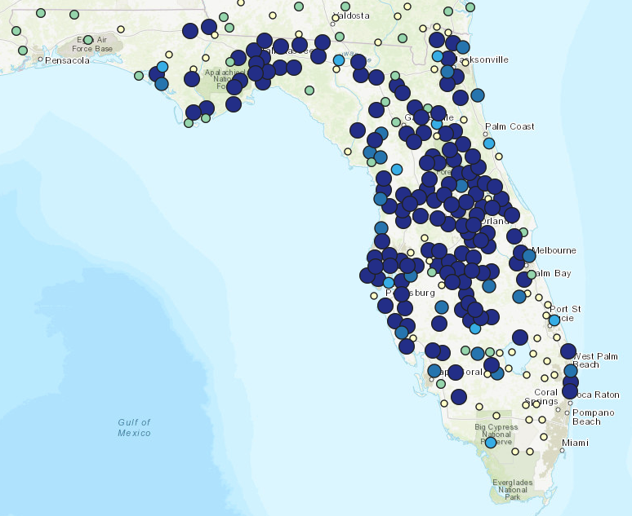
Water hyacinth
Eichhornia (Pontederia) crassipes
Introduced in the 1880s for cattle feed and horticulture
Native to South America
Resource competition with macrophytes
Habitat for macroinvertebrates
Reduces habitat suitability for fish (low dissolved O₂)
High leaf turnover and decomposition, affects water quality
Herbicides, mechanical, and biocontrol
(USGS)

Slide 6
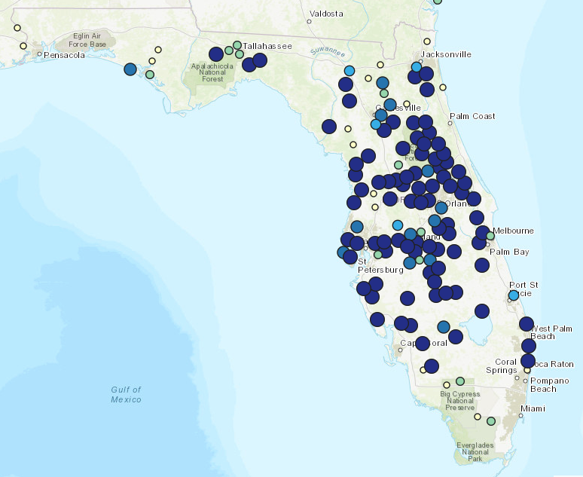
Water lettuce
Pistia stratiotes
Introduced with Spanish settlers, maybe in ballast water
Native to South America
Mats less common after the introduction of water hyacinth
Resource competition with macrophytes
Habitat for macroinvertebrates
Bioaccumulates metals
Herbicides, mechanical, and biocontrol
In 1990’s, management costs (with water hyacinth) second to hydrilla
(USGS)

Slide 7
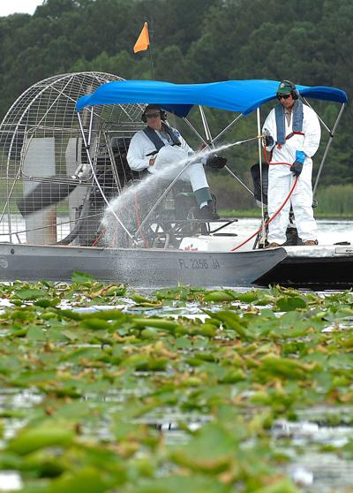
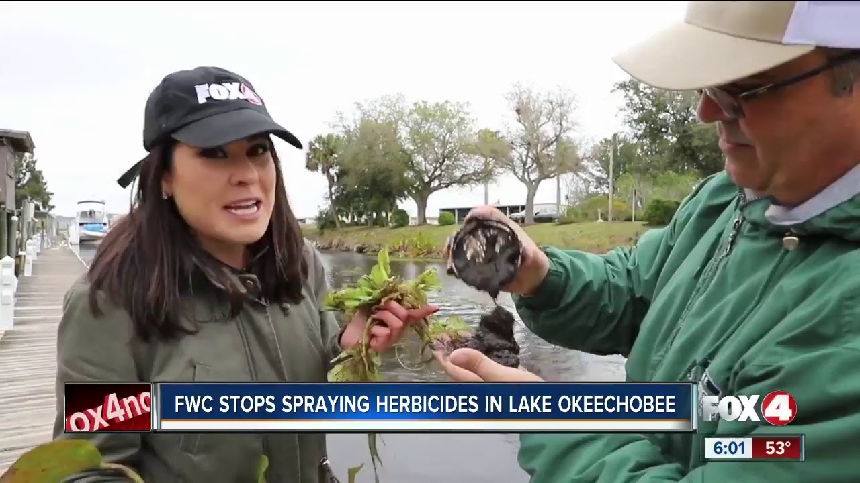
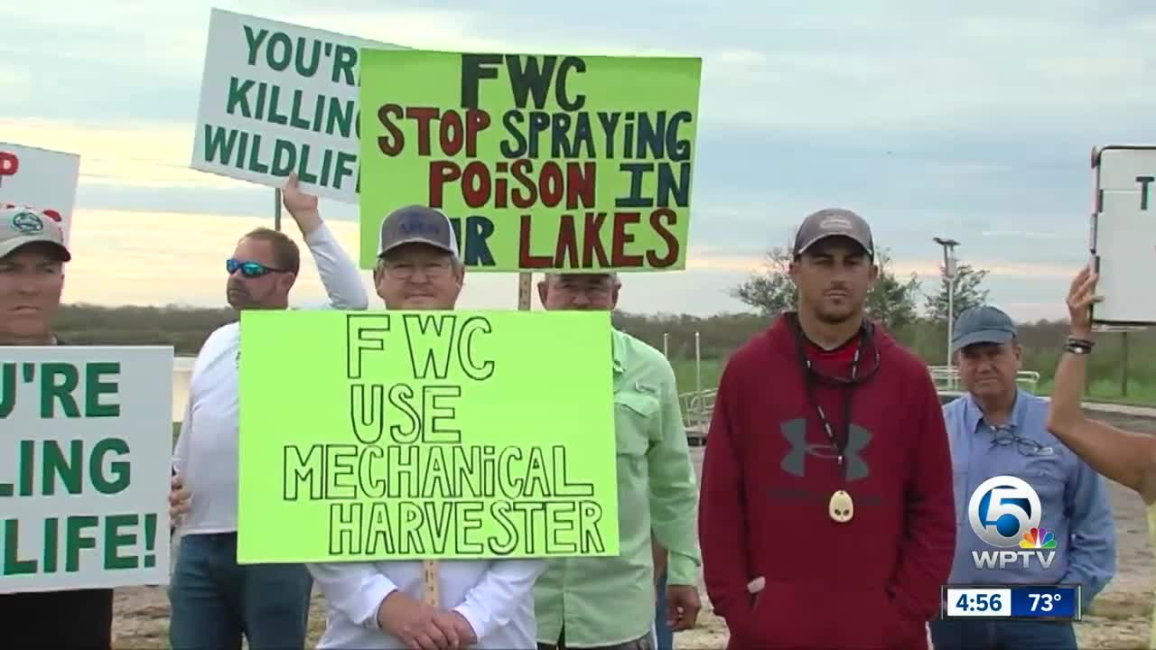
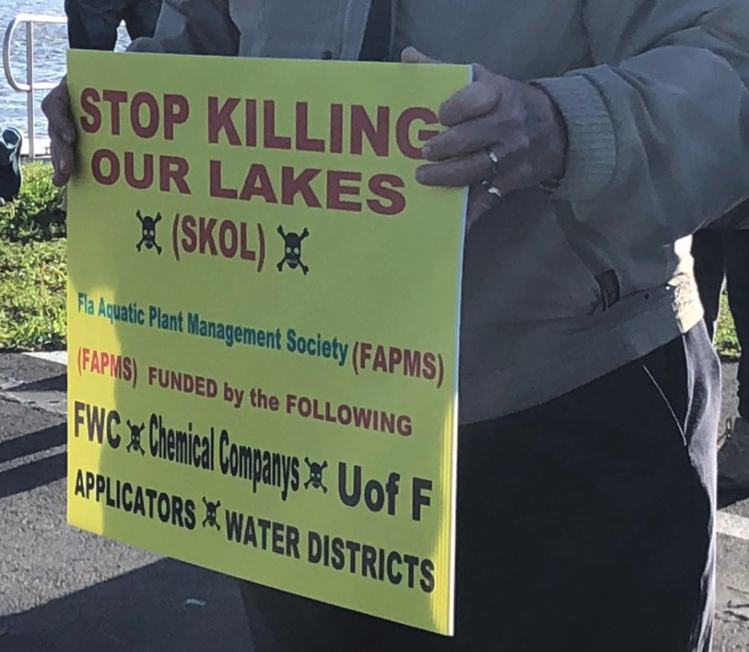
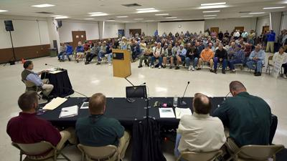
Notes:
https://www.wpbf.com/article/protests-planned-against-fwc-use-of-chemical-herbicide-in-lake-okeechobee/31028532#

Slide 8
Project aims
How effective is aquatic invasive plant management?
How do aquatic invasive plants affect…
water quality?
fish populations?
native plant species?
What are the side effects of invasive plant management?

Slide 9
Long-term datasets

Slide 10
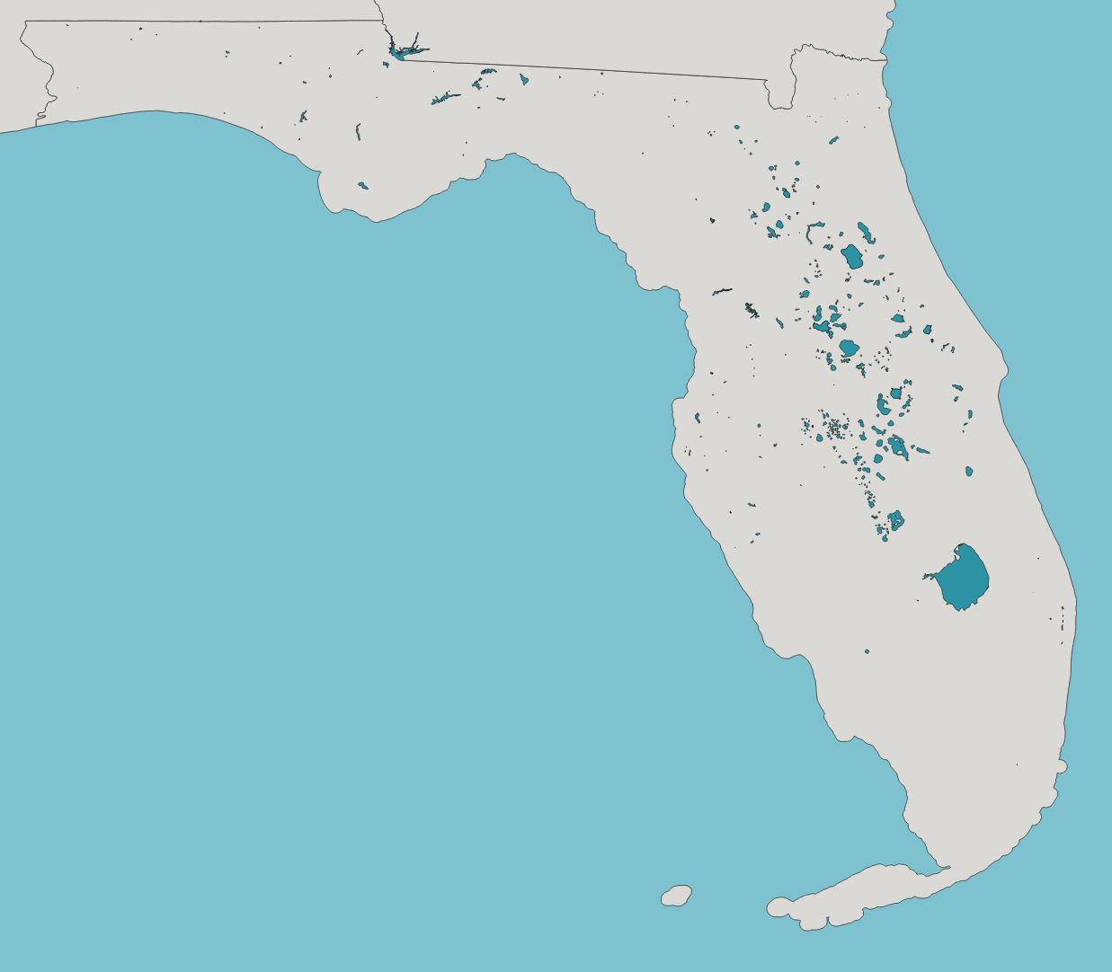
FWC Lakes
372 lakes with ≥ 5 years of plant and management data
Suggestions for map?
Plant populations
Management intensity
Dataset types

Slide 11
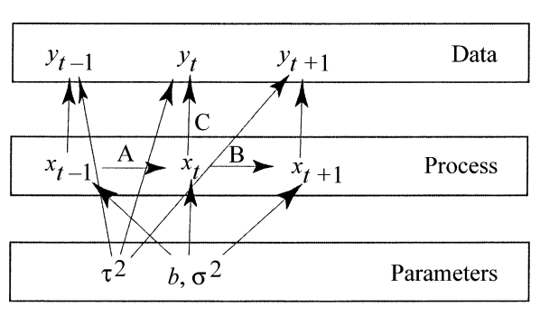
State space model
observation
error
demographic or environmental
stochasticity
deterministic effects on population
(Clark and Bjørnstad 2004)

Slide 12
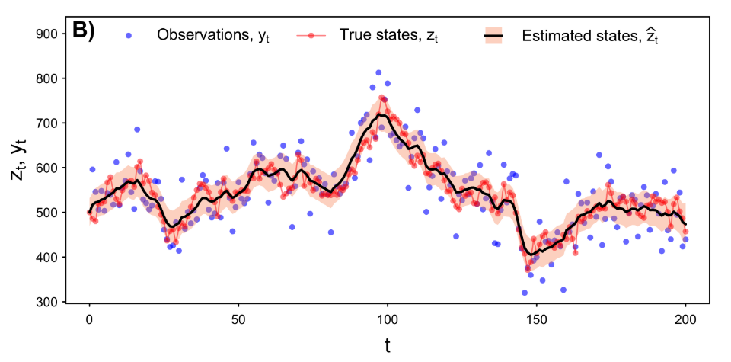
State space model
(Auger-Méthé et al. 2020)

Slide 13
Things we need to take into consideration:
Survey timing
Missing data
Metapopulation

Slide 14
Survey timing

Slide 15
Survey timing
Model assumption: add 10% error for each month past the most frequently sampled month
Future direction:
characterize within-year fluctuations
J = months from most frequently sampled month for that lake

Slide 16
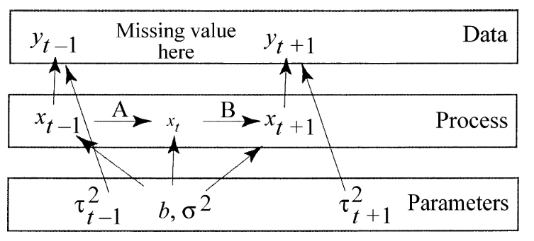
Missing data
(Clark and Bjørnstad 2004)

Slide 17
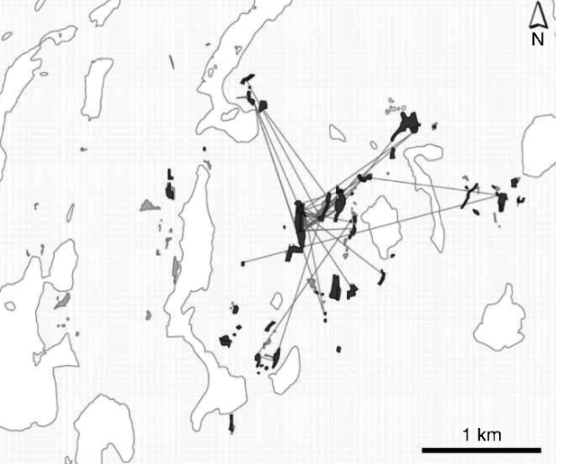
Metapopulation
Habitat patches with local population dynamics
Dispersal between patches
Interested in both local and regional (metapopulation) dynamics
Local: resident that fishes on a specific lake
Regional: invasive species eradication
Fritillary butterfly metapopulation on Åland Island in Finland
(Harrison et al. 2011)

Slide 18
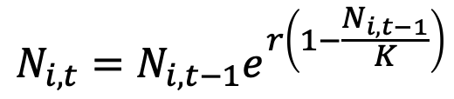
Metapopulation
Local population dynamics:
Discrete logistic growth
$$N_{i,t}=N_{i,t−1}e^{r\left(1−\frac{N_{i,t−1}}{K}\right)}$$

Slide 19
Metapopulation
Local population dynamics:
Discrete logistic growth
Log-transform and add herbicides
$$N_{i,t}=N_{i,t−1}e^{r\left(1−\frac{N_{i,t−1}}{K}\right)}$$
$$x_{i,t}=x_{i,t−1}+r+b_{K}e^{N_{i,t−1}}−b_{H}H_{i,t−1}$$

Slide 20
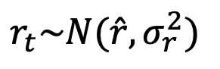
Metapopulation
Local population dynamics:
Discrete logistic growth
Log-transform and add herbicides
$$N_{i,t}=N_{i,t−1}e^{r\left(1−\frac{N_{i,t−1}}{K}\right)}$$
$$x_{i,t}=x_{i,t−1}+r+b_{K}e^{N_{i,t−1}}−b_{H}H_{i,t−1}$$
Regional population dynamics:
Growth rate varies by year, but is consistent across lakes
$r_{t}\sim N(\hat{r},σ_{r}^{2})$

Slide 21
Metapopulation
Local population dynamics:
Discrete logistic growth
Log-transform and add herbicides
$$N_{i,t}=N_{i,t−1}e^{r\left(1−\frac{N_{i,t−1}}{K}\right)}$$
$$x_{i,t}=x_{i,t−1}+r+b_{K}e^{N_{i,t−1}}−b_{H}H_{i,t−1}$$
Regional population dynamics:
Growth rate varies by year, but is consistent across lakes
Future directions:
Carrying capacity varies by lake
Dispersal among lakes
$r_{t}\sim N(\hat{r},σ_{r}^{2})$

Slide 22
Simulated data

Slide 23
More information
Other observations of the same process:
FWC point-intercept surveys
Lakewatch plant surveys
Prior for observational error:
Okeechobee helicopter surveys

Slide 24
More information
Other observations of the same process:
FWC point-intercept surveys
Lakewatch plant surveys
Prior for observational error:
Okeechobee helicopter surveys
Estimates for:
Initial population size (x₀)
Growth rate (b_{r})
Process error variance (𝜎²_{P})
Observation error variance (𝜎²_{O})
(Jamieson and Brooks 2004)

Slide 25
Pre-herbicide Model
$$x_{t}=x_{t−1}+b_{r}+ε_{t}$$
Temporary assumptions:
No carrying capacity
$$y_{t}$$
$$x_{t}$$

Slide 26
Post-herbicide Model
$$x_{t}=x_{t−1}+b_{r}−b_{H}H_{t−1}+ε_{t}$$
Temporary assumptions:
No carrying capacity

